Slide 1
Lecture 6
Interrupts

Slide 2
The Nuts and Bolts of Responding to Events
Handling interrupts require both hardware and software cooperation
Hardware Portion
How x86 handles hardware interrupts
Software Portion
How a kernel handles interrupts

Slide 3
The General Computing Environment
Central
Processing
Unit
Main
Memory
system bus
I/O
device
I/O
device
I/O
device
I/O
device

Slide 4
Why interrupts?
I/O an integral part of any computing system
Disk drives, keyboard or other human interface, etc.
Apps and users expect responsiveness
The unexpected can arise
Errors, faults, exceptions

Slide 5
Instruction Processing Cycle
Fetch instruction at IP
Decode the fetched instruction
Save context
Execute the decoded instruction
Get INTR ID
Interrupt?
yes
Lookup ISR
no
Advance IP to next instruction
IRET
Execute ISR

Slide 6
What is an interrupt?
A forced change in the flow of control
Hardware performs simple context switching
Kernel entered at a specific predetermined point
Normal execution resumes with a special “iret” instruction that also restores the context
Many different types for different purposes

Slide 7
Types of Interrupts
Asynchronous
Source is external such as I/O device
Not related to instruction currently being executed
Synchronous (also called exceptions)
Processor-detected exceptions:
Faults — offending instruction is retried (eg. page faults)
Traps — instruction is not retried
Aborts — major error (hardware failure)
Programmed exceptions:
Requests for kernel intervention (eg. syscalls)

Slide 8
Faults
Normal execution cannot continue
Examples:
Writing to a memory segment marked ‘read-only’
Reading from an unavailable memory segment (on disk)
Executing a ‘privileged’ instruction
The causes of ‘faults’ can often be ‘fixed’
If the issue can be resolved, then the CPU can just restart its execution-cycle

Slide 9
Related: instruction replay
Modern processors have deep pipeline and superscalar execution
Corollary: aggressive instruction issue means that an instruction may be issued before it is known to be safe to do so
Problem: deep into an instruction’s execution, dependency or exception arise
Since Pentium 4, Intel has implemented a hardware replay queue
Faulting instructions will be placed in a queue to be replayed

Slide 10
Traps
Example: A CPU might have been programmed to automatically switch control to a ‘debugger’ program at specific program point
INT 3 (opcode 0xCC) used by debuggers on x86
This is known as a ‘trap’
Coz it is deliberately set

Slide 11
Error Exceptions
Most error exceptions are translate directly into signals
Divide by zero
Privileged instruction
Illegal memory referencing, etc.
The kernel’s job is fairly simple: send the appropriate signal to the current process
force_sig(sig_number, current);
Most of the time, the process by default gets killed
That’s not the concern of the exception handler
One important exception: page fault
An exception can (infrequently) happen in the kernel
die(); // kernel oops

Slide 12
Interrupt: The Hardware Story

Slide 13
In the good old days…
IRQs
Interrupt Request (IRQ)
Slave
PIC
(8259)
Master
PIC
(8259)
x86
CPU
Ethernet
INTR
SCSI Disk
Real-Time Clock
Keyboard Controller
Programmable Interval-Timer
Legacy PC Design

Slide 14
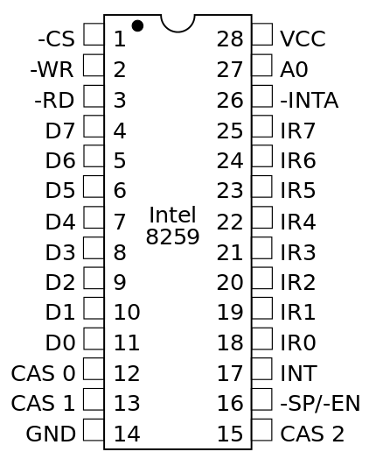
Intel 8259 Programmable Interrupt Controller
Expands on the original interrupt capability of the 8085 processor
Can accept 8 interrupt requests, allowing them one by one to the processor INTR pin
Programmable priorities of interrupts
Can be cascaded to allow up to 64 interrupts

Slide 15
How it worked - 1
First, it has to be initialized
When ready, it receives interrupt through IR0 to IR7
Checks if an interrupt is masked or not, and what is its priority
If all ok (previous interrupt completed, current interrupt highest priority and not masked), send INT signal to INTR pin of 8085
In response, processor sends three INTA signal

Slide 16
How it worked - 2
Processor sends first INTA signal
8259 responds with x86 CALL opcode
Processor sends second INTA signal
8259 responds with low byte of call address
Processor sends third INTA signal
8259 responds with high byte of call address
Processor saves current PC on stack, executed CALL instruction using the 16-bit address (the interrupt servicing routine) the 8259 sent

Slide 17
Advanced Programmable Interrupt Controller (APIC)
8259 cannot handle multiprocessor system
With more than one CPUs, send interrupt to who?
How to implement inter-processor interrupt (IPI)?
PIC updated with the APIC – actually a system
In APIC, each CPU consists of a “core” and a “local APIC” (LAPIC)
Contains a Local Vector Table
In addition, there is an separate I/O APIC
Part of the chipset
If system has multi I/O subsystem, then multiple I/O APIC

Slide 18
APIC, IO-APIC, LAPIC
Advanced PIC (APIC) for multiprocessor systems
Used in all modern systems
Interrupts “routed” to CPU over system bus
Supports inter-processor interrupt (IPI)
Local APIC (LAPIC) versus “frontend” IO-APIC
Devices connect to front-end IO-APIC (cascading)
IO-APIC communicates (over bus) with Local APIC
Interrupt routing
Allows broadcast or selective routing of interrupts
Ability to distribute interrupt handling load
Routes to lowest priority process
Special register: Task Priority Register (TPR)
Arbitrates (round-robin) if equal priority

Slide 19
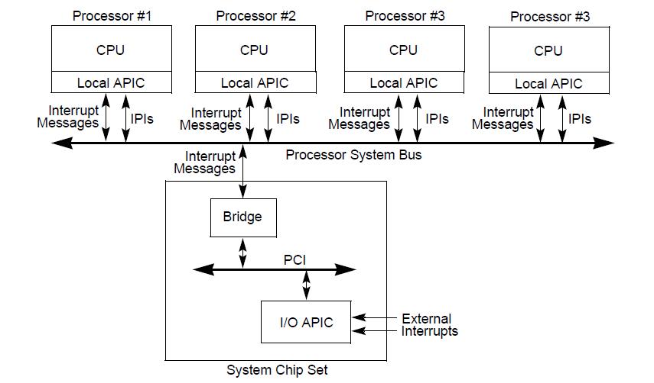
APIC system

Slide 20
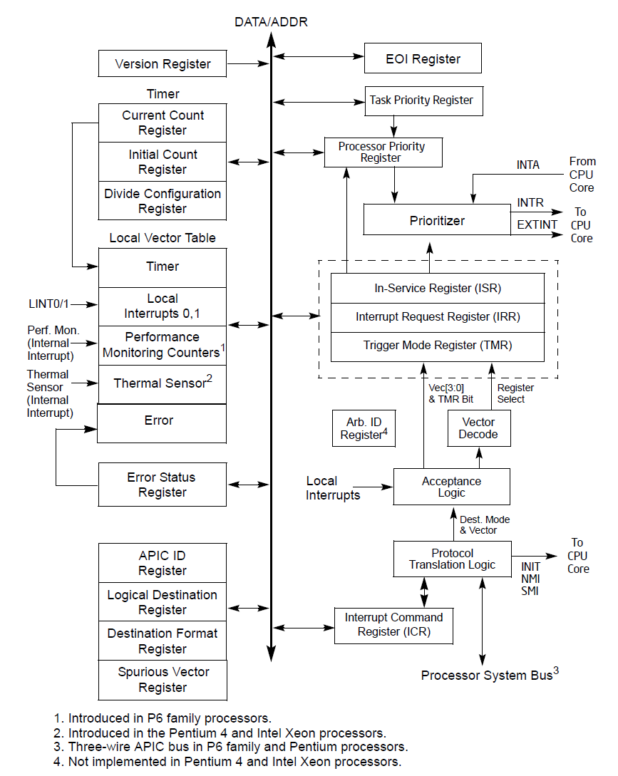
Local APIC

Slide 21
Interrupts to Local APIC
Locally connected I/O devices — An I/O device that is connected directly to the processor’s local interrupt pins (LINT0 and LINT1
Externally connected I/O devices — Connected to the interrupt input pins of an I/O APIC
Inter-processor interrupts (IPIs) — For software self-interrupts, interrupt forwarding, or preemptive scheduling.
APIC timer generated interrupts
Performance monitoring counter interrupts
Thermal Sensor interrupts — When the internal thermal sensor has been tripped
APIC internal error interrupts

Slide 22
Local Vector Table
The processor’s LINT0 and LINT1 pins, the APIC timer, the performance-monitoring counters, the thermal sensor, and the internal APIC error detector are referred to as local interrupt sources
A (programmable) local vector table is looked up to translate these to system-wide interrupt vectors

Slide 23
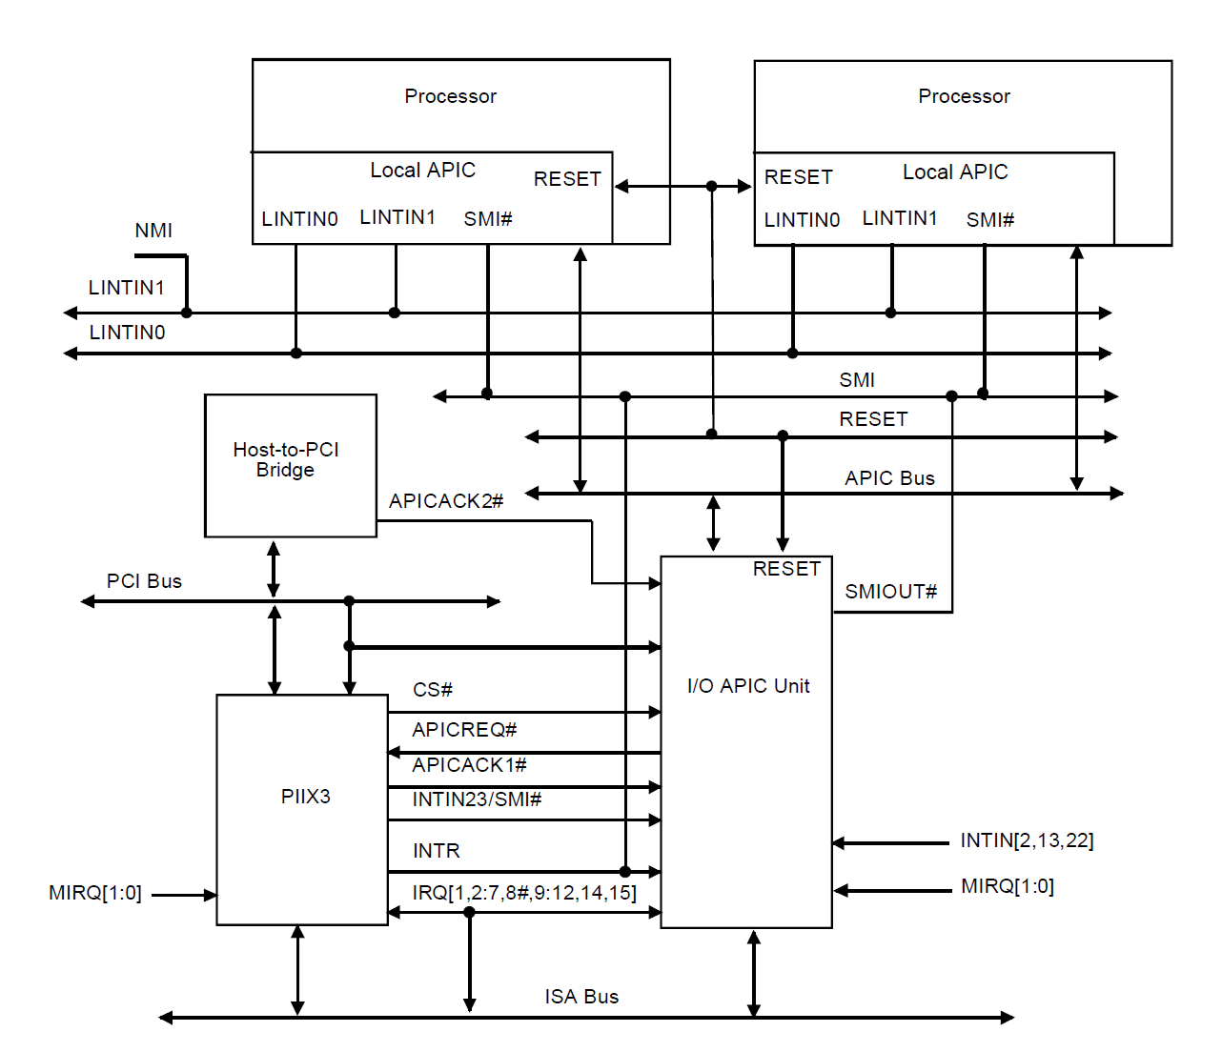
I/O APIC
PCI chip
Intel 82093AA (IOAPIC)

Slide 24
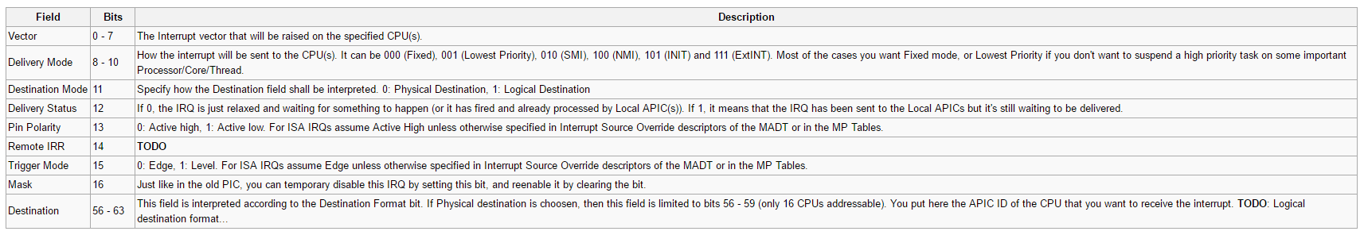
I/O APIC
Each IRQ associated with a 64 bit register

Slide 25
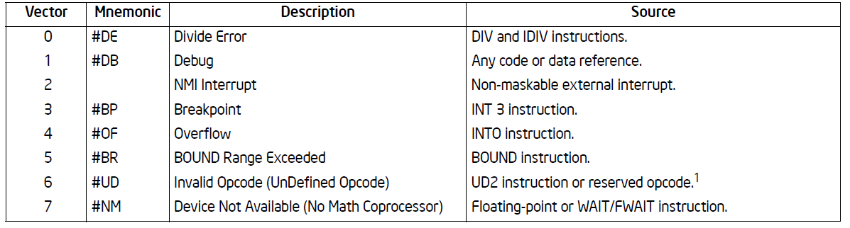
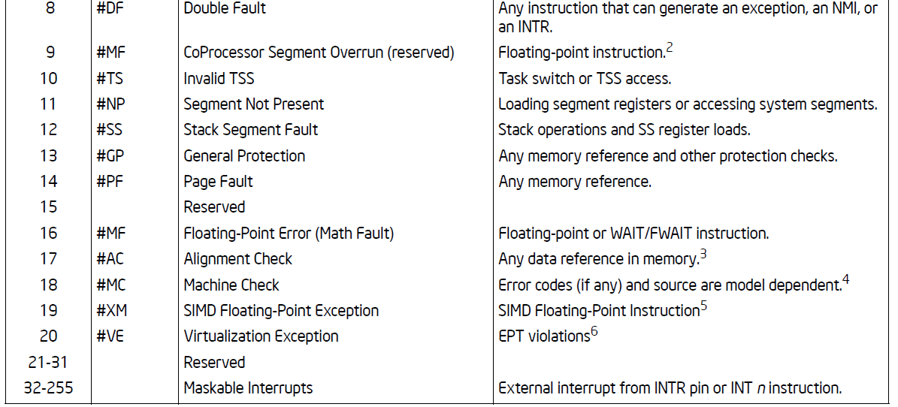
Intel Reserved Interrupts
Intel Reserved

Slide 26
Assigning IRQs to Devices
IRQ assignment is hardware-dependent
Sometimes it’s hardwired, sometimes it’s set physically, sometimes it’s programmable
PCI bus usually assigns IRQs at boot
Some IRQs are fixed by the architecture
IRQ0: Interval timer
IRQ2: Cascade pin for 8259A
Linux device drivers request IRQs when the device is opened
Two devices that aren’t used at the same time can share an IRQ, even if the hardware doesn’t support simultaneous sharing

Slide 27
Assigning Vectors to IRQs
The interrupt vector is an index (0-255) into the interrupt descriptor table
Vectors usually IRQ# + 32
Below 32 reserved for non-maskable interrupt and exceptions
Maskable interrupts can be assigned as needed
Vector 128 used for Linux syscall
Vectors 251-255 used for IPI

Slide 28
How x86 handles interrupts

Slide 29
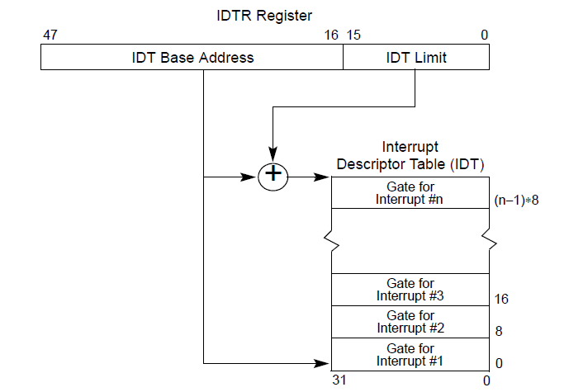
Basic flow
The Interrupt Descriptor Table Register (IDTR) points to a table (IDT) consisting of either:
Task-gate descriptor
Interrupt-gate descriptor
Disables further interrupts
Trap-gate descriptor
Further interrupts still allowed
On an interrupt, the vector is used to look up the table and the corresponding actions are taken

Slide 30
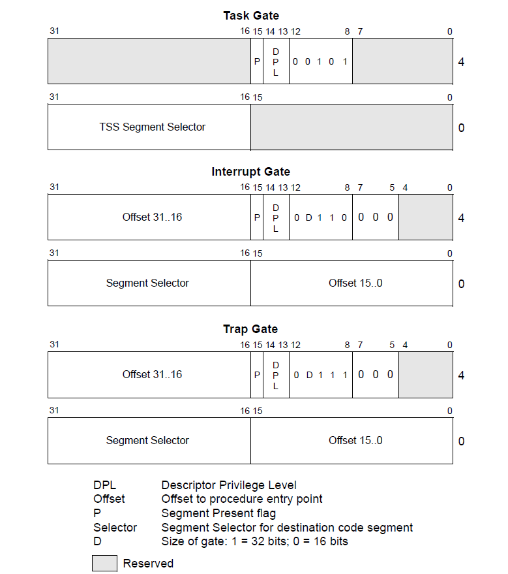
(32 bit) Gate Descriptors
Privilege level
of handler

Slide 31
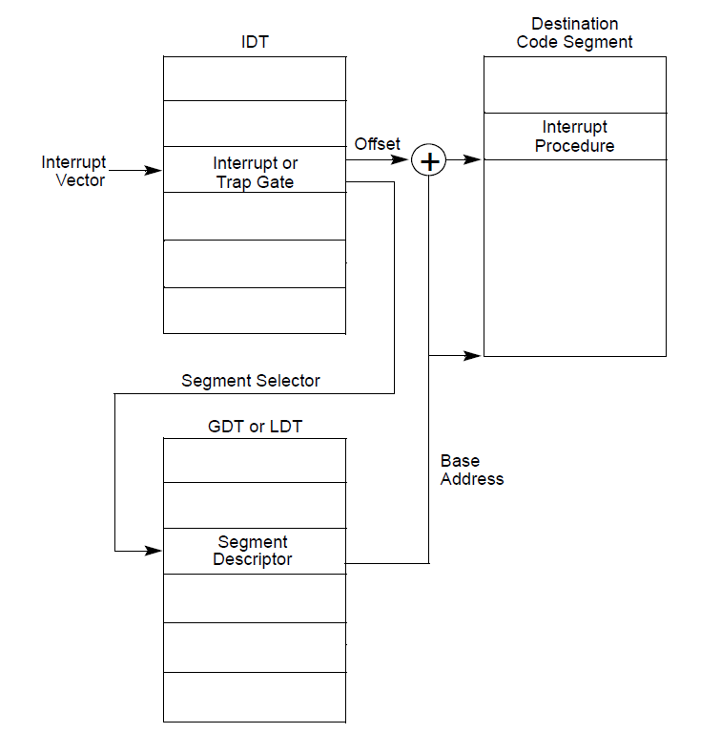
Interrupt Procedure Calls
If the handler procedure is going to be executed at a numerically lower privilege level (i.e., higher privilege), a stack switch occurs. The stack specified in the current process’ TSS is used.
Else, use current stack.
You see why we need a faster way to do syscall rather than through interrupts?

Slide 32
A digression: Task State Segment
Originally meant for hardware task switching in 32-bit
Never used by Linux for process switching
Still there in 64 bit but in 64 bit hardware task switching is not supported
Basically, a state context with the contents of all registers
Most important use: supply an alternative stack (kernel stack) for calling more privileged procedures
Only use of it in Linux
Pointed to by the privileged tr register
IDT can contain task gates and in 32-bit system will trigger a hardware task switch

Slide 33
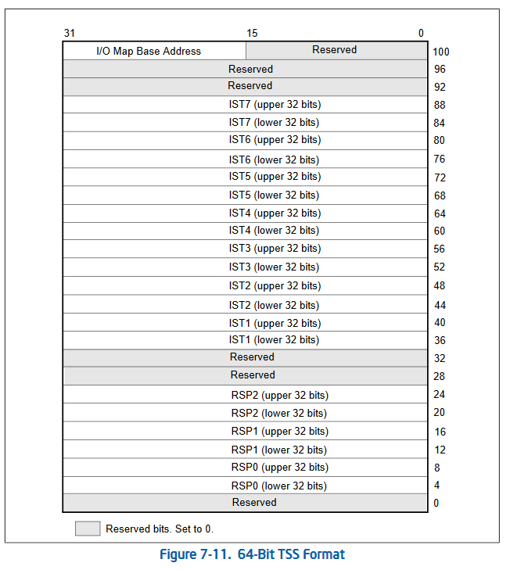
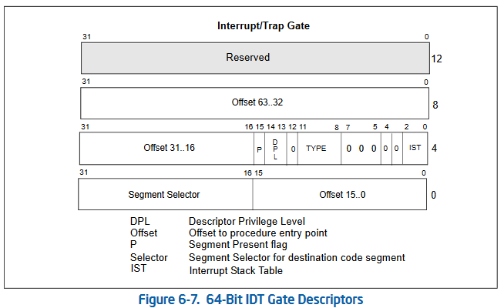
Task State Segment
Intended by Intel to be used for interrupt stacks. But Linux only use it for a few severe exceptions like double-fault.
If non-zero…
Linux uses one TSS for each CPU
Ring 2 stack
Ring 1 stack
If zero…
Ring 0 stack

Slide 34
Interrupt Stack Table
ESTACK_DF
INT8 - Double Fault Exception
Invoked when an exception occurs while handling another exception
ESTACK_NMI
INT2 - Non-maskable interrupt
ESTACK_DB
Hardware debug interrupts (INT1) and for software debug interrupts (INT3)
ESTACK_MCE
INT18 – Machine Check Exception
Each stack is of size 4K (1 page)

Slide 35
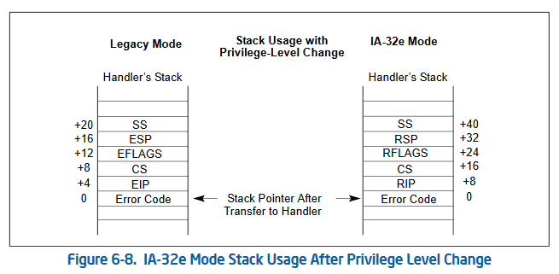
Stack Switching
In 32 bit, rely on hardware task switching to switch stack
In 64 bit, done in entry_SYSCALL_64 of arch/x86/entry/entry_64.S

Slide 36
Linux and IDT
BIOS will initialize and use the IDT
When Linux boots, it will overwrite introduce a new table idt_table
In arch/x86/kernel/traps.c:trap_init() meaningful values will be written in
Later on, drivers will request for IRQ from kernel

Slide 37
How Linux initialize the IDT
All Linux interrupt handlers are activated via interrupt gates, and all restricted to kernel mode; no user mode access
Linux calls these “interrupt gates”
Interrupt 4 (overflow), 5 (bounds check), and 128 (int 0x80) activates interrupt gates that are at Ring 3 (user mode)
Linux calls these “system gates”
Interrupt 3 (breakpoint) is implemented via an interrupt gate at user mode privilege
Linux calls this “system interrupt gate”
Most Linux trap handlers are activated via trap gates, all restricted to kernel mode
Linux calls these “trap gates”
The sole use of a task gate in Linux is for the “double fault” exception. It is in Ring 0.

Slide 38
Multiple IDTs
Immediately after kernel boots:
early_idts[] in arch/x86/kernel/idt.c:57
Pre-IST stack version:
def_idts[] in arch/x86/kernel/idt.c:76
Post-IST stack version:
ist_idts[] in arch/x86/kernel/idt.c:228

Slide 39
Setting up interrupt handling
There are a number of varieties of IDT entries and their handlers, and macros are used to generate the “entry stubs”
From interrupt 32 (known by a constant FIRST_EXTERNAL_VECTOR) onwards, the interrupts are handled in the same way, with a small exception.
If local APIC is turned on, then all interrupts above number 236 are “spurious” and treated as error.
Otherwise, all handled the same way.
All will use sp0 entry stack

Slide 40
Workflow
Every IDT vector that does not explicitly point somewhere else gets set to the corresponding value in interrupts
Hardware will interrupt a CPU (according to how it is programmed)
The IRQ will fire off the routine specified in the corresponding IDT entry
IDT entries generated by assembly and macro voodoo
Special exceptions have special handlers
General interrupts eventually make their way to common_interrupt() (used to be called do_IRQ)

Slide 41
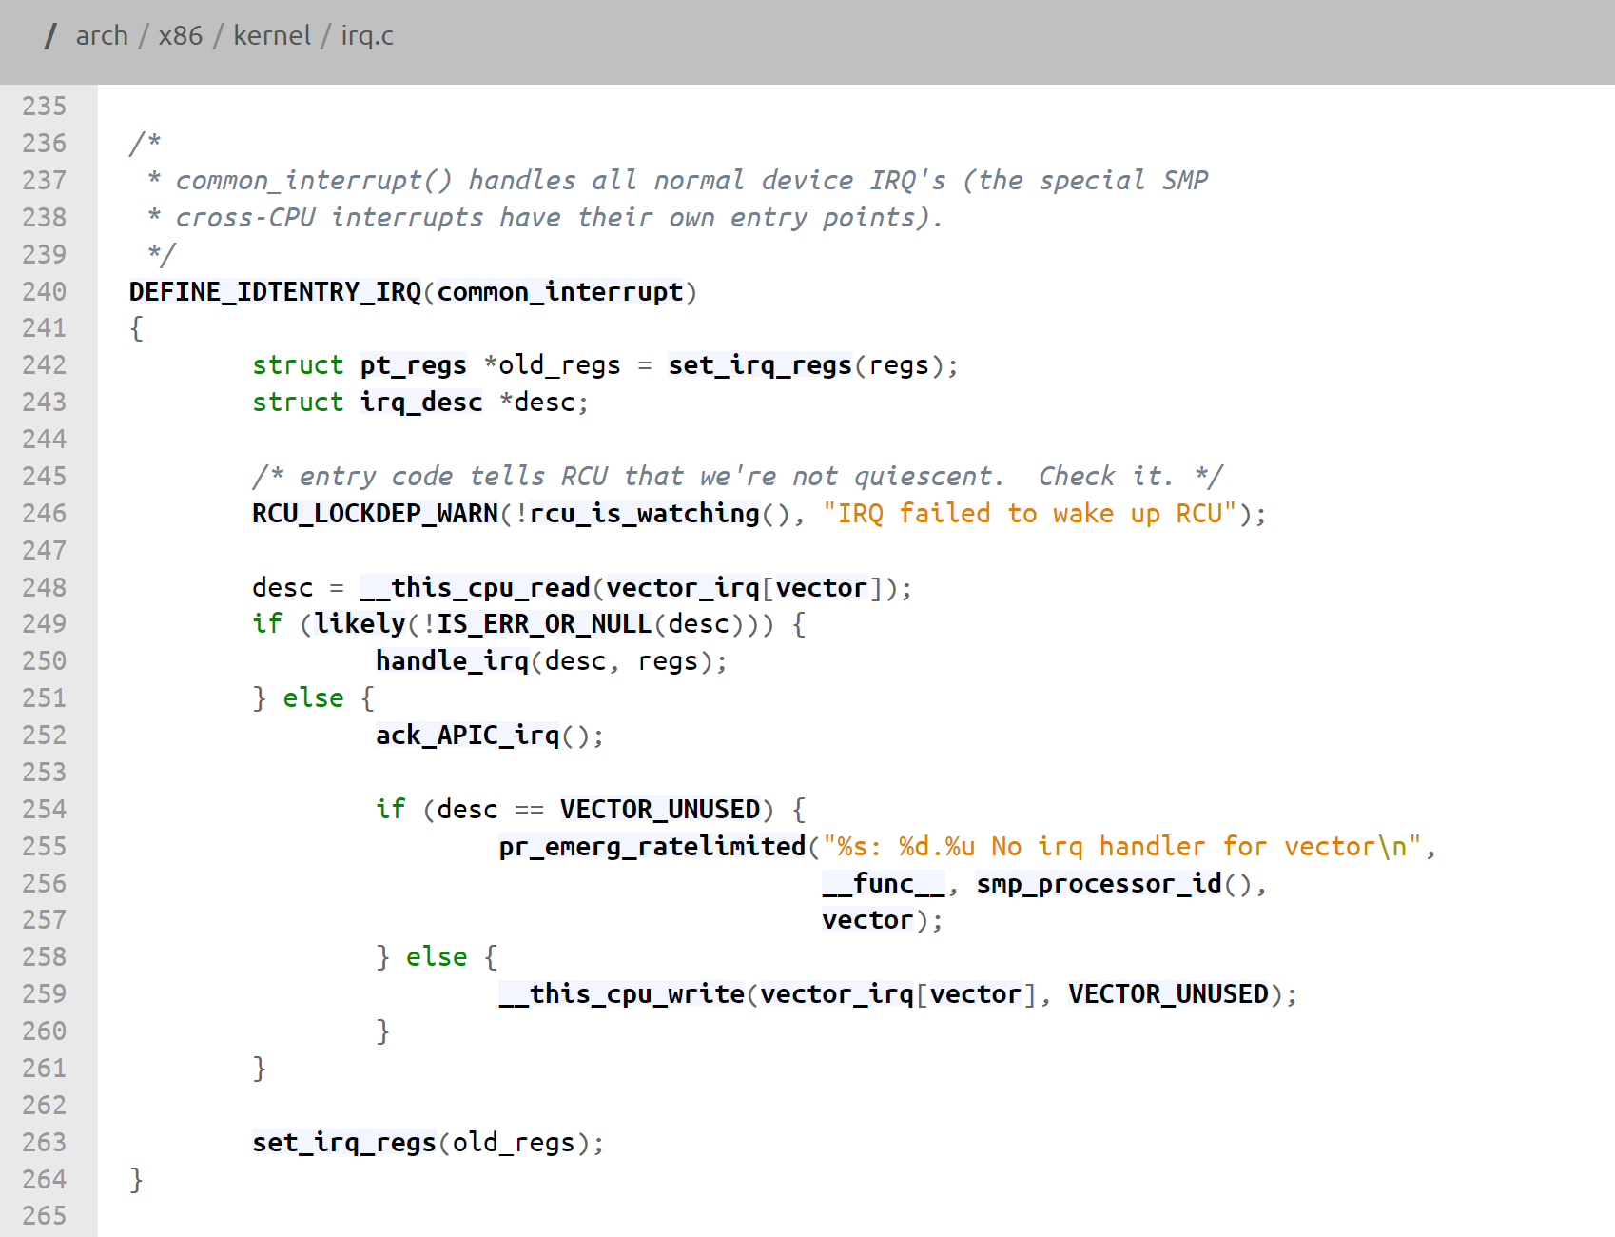
/arch/x86/kernel/irq.c
Generated assembly stub would have switch stack
From entry sp0 to hardirq_stack
Dispatch from a software table for further processing
request_threaded_irq() by device driver to install an interrupt service routine (ISR) which is a member of struct irq_desc

Slide 42
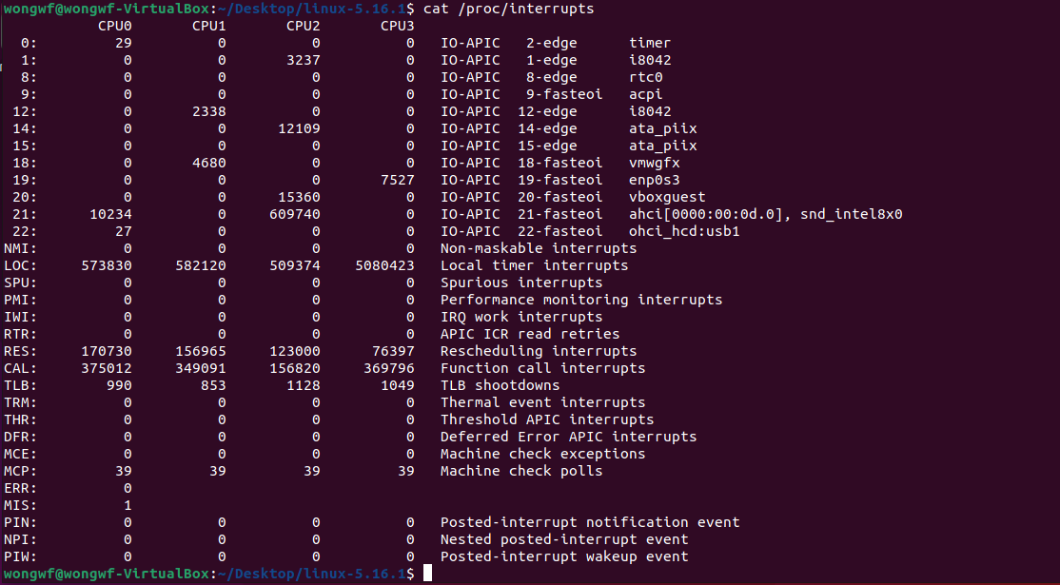
/proc/interrupts
i8042 chip is the keyboard and
mouse controller

Slide 43
Nested interrupts
A second (or even more) interrupt may come while the one is being serviced
Linux used to support nested interrupts but this was removed to avoid complex solutions to interrupt stack overflows issues
However, it is still possible to have nesting between exceptions and interrupts but the rules are fairly restrictive:
an exception (e.g. page fault, system call) can not preempt an interrupt; if that occurs it is considered a bug
an interrupt can preempt an exception
an interrupt can not preempt another interrupt (it used to be possible)

Slide 44
Nuts and bolts
On entry to an interrupt handling, check if there was a privilege change
Done by check CS register
Constant __USER_CS if in user mode
Constant __KERNEL_CS if in kernel
If a privilege level change, do the same entry steps as SYSCALL
swapgs to bring in per CPU data structure
SWITCH_TO_KERNEL_CR3 to bring in full kernel page tables
Change stack to per task kernel stack
If no privilege level change, do not do these!

Slide 45
The OS aspect
The Linux Story

Slide 46
The overall strategy
Divide interrupt handling into two parts
Top half – immediate handler
Do the absolute minimal to handle the interrupt and return as quickly as possible
IRQ disabled → acknowledge IRQ → execute device handler → IRET
Enables near immediate response to new interrupts
No clear process context
Push the bulk of the non-critical processing to Part 2
Bottom half – deferrable functions
Not time critical work
IRQ enabled – can be interrupted
Mechanisms: tasklet, softirq, work queue, kernel thread

Slide 47
Top half
Do the bare minimum amount of work to safely
Save registers
Unmask all other interrupts
Exceptions are handled simply by sending a signal to the process that caused the exception
I/O interrupt has to be handled using the current process

Slide 48
Limitations of an interrupt service routine
Cannot sleep or call something that might sleep
Cannot refer to current (pointer to the current process)
Cannot do kmalloc(…, GFP_KERNEL) (which can sleep)
Must use kmalloc(…, GFP_ATOMIC) (which can fail)
Cannot call schedule()
Cannot do a down() semaphore call
But can do an up()
Cannot transfer data to/from user space

Slide 49
The Interrupt Stacks
Interrupt service routines mostly written in C – hence need stack
Exceptions use the kernel-level exception stack of the current process
Kernel stack is the stack in the kernel space of the current process
One per process whose address is located in the process data structure
The reason why cannot switch user context or sleep
Interrupts uses a hard IRQ stack
One per processor, only one page frame in size
SoftIRQ uses soft IRQ stack
On 32 bit x86, a separate soft IRQ stack
On 64 bit x86, soft IRQ stack == hard IRQ stack, a.k.a. the “interrupt stack”
The latter two configured in the IDT and TSS at boot time

Slide 50
Three types of interrupts
I/O interrupts – I/O device requires attention
Three possible types of actions: critical, non-critical, non-critical deferrable
Timer interrupts
Interprocessor interrupts
See: arch/x86/include/asm/idtentry.h

Slide 51
I/O interrupts
IRQ are few and hence a precious resource
IRQ sharing
More than one device may share the same IRQ
Every service routine registered for the same IRQ must be tried coz you don’t know which is the right one
IRQ allocation
Device driver requests for IRQ assignment at the last possible moment just before use

Slide 52
A complication in SMP: lost IRQ
IRQ a comes, CPU x handles
IRQ b comes, CPU y handles
Because of interrupt masking at beginning of process, before, say, CPU x can acknowledge, CPU y masks out all interrupts
CPU x mistakenly thinks IRQ a disabled, returns without processing
IRQ a is “lost” (unprocessed)
Needs additional checking for this case

Slide 53
Bottom Half – deferrable functions
SoftIRQ – “software” IRQ
Tasklet
Work queue
Kernel thread

Slide 54
SoftIRQ
In many ways, behaves like a hardware IRQ but done entirely in software
Re-entrant code
Different processors may execute the same softIRQ handlers at the same time
Must protect data structures using spinlocks
Can be interrupted
All hardware interrupts enabled
Data structure: softirq_vec[] – an array of handlers

Slide 55
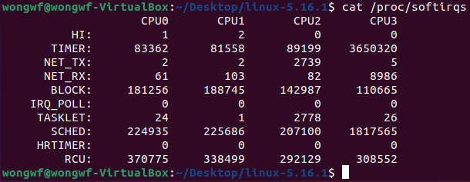
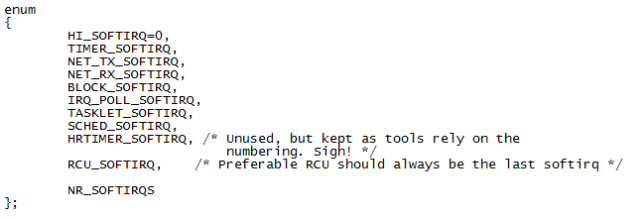
SoftIRQ vectors
include/linux/interrupt.h

Slide 56
SoftIRQ processing
Initialization – done by open_softirq()
Activation – raise_softirq()
Masking
Needed when a processor wants to change the softIRQ data structure
Execution

Slide 57
Executing softIRQ
Run at various points by the kernel:
After system calls
After exceptions
After interrupts (top halves/IRQs, including the timer intr)
When the scheduler runs ksoftirqd
Softirq routines can be executed simultaneously on multiple CPUs:
Code must be re-entrant
Code must do its own locking as needed

Slide 58
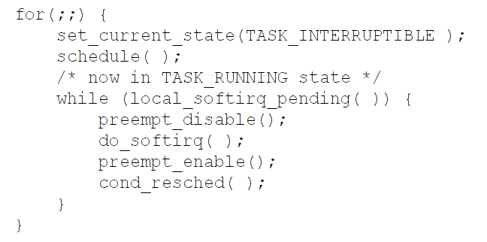
ksoftirqd
One daemon per processor
Infinite loop check for and servicing softIRQ on that particular processor

Slide 59
Tasklets
Implemented on top of softIRQ using HI_SOFTIRQ and TASKLET_SOFTIRQ
Only real difference: HI_SOFTIRQ-based tasklets run prior to the TASKLET_SOFTIRQ tasklets
Invoked either the tasklet_schedule( ) function or the tasklet_hi_schedule( )

Slide 60
Tasklets vs softIRQ
Tasklets can be statically or dynamically allocated
SoftIRQ is fixed
Tasklets are not re-entrant
Tasklets of the same type runs serially in the entire system
Two tasklets of different types may run concurrently

Slide 61
Work Queues
SoftIRQ and tasklets run in the interrupt context, work queue functions run in the process context
Work queue functions allowed to sleep
All cannot access user space
Work queues can be created dynamically
Or use the predefined (per CPU) “events” work queue
A worker thread waits for work in the work queue

Slide 62
Kernel Threads
Always operate in kernel mode
Again, no user context
2.6.30 introduced the notion of threaded interrupt handlers
Imported from the realtime tree
request_threaded_irq()
Now each bottom half has its own context, unlike work queues
Idea is to eventually replace tasklets and work queues

Slide 63
request_threaded_irq()
Supplies a IRQ number, a handler and a threaded function
Spawns a new kernel thread using the threaded function
Handler is the hard IRQ handler
Determine interrupt cause
Returns IRQ_HANDLED or IRQ_WAKE_THREAD
If IRQ_WAKE_THREAD, schedule kernel thread created during setup for execution
As part of thread scheduling, threaded function will eventually be executed

Slide 64
A comparison
 | ISR | SoftIRQ | Tasklet | WorkQueue | KThread
Will disable all interrupts? | Briefly | No | No | No | No
Will disable other instances of self? | Yes | Yes | No | No | No
Higher priority than regular scheduled tasks? | Yes | Yes* | Yes* | No | No
Will be run on same processor as ISR? | N/A | Yes | Yes | Yes | Maybe
More than one run can on same CPU? | No | No | No | Yes | Yes
Same one can run on multiple CPUs? | Yes | Yes | No | Yes | Yes
Full context switch? | No | No | No | Yes | Yes
Can sleep? (Has own kernel stack) | No | No | No | Yes | Yes
Can access user space? | No | No | No | No | No
*Within limits, can be run by ksoftirqd

Slide 65
Signals

Slide 66
Unix Signals
A signal is a notification of an event
User application is stopped immediately
A user-supplied signal handler will execute to completion
This handler is an userspace procedure
User application will resume where it left off
If no handler supplied, default action is taken
Usually a core dump followed by process termination

Slide 67
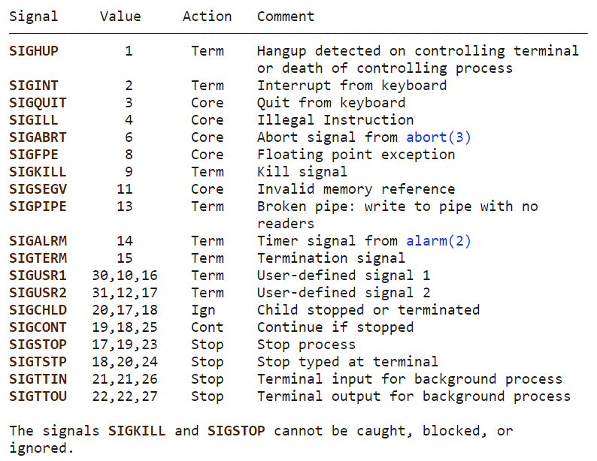
POSIX.1-1990 Signals

Slide 68
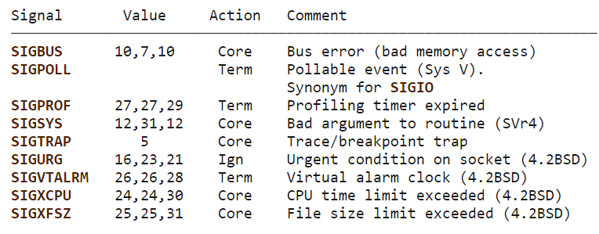
POSIX.1-2001 Signals

Slide 69
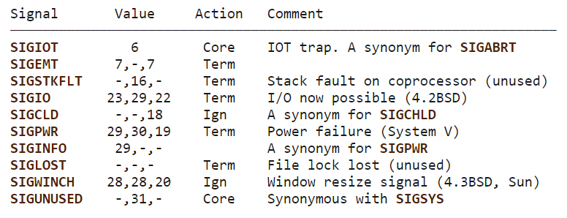
Other signals

Slide 70
Examples from the keyboard
Ctrl-c → 2/SIGINT signal
Default handler exits process
Ctrl-z → 20/SIGTSTP signal
Default handler suspends process
Ctrl-\ → 3/SIGQUIT signal
Default handler exits process

Slide 71
Sending signals
You can do it at command line using the kill command
kill -signal pid
Send a signal of type signal to the process with id pid
Can specify either signal type name (-SIGINT) or number (-2)
If no signal type name or number specified, SIGTERM (15) will be sent
Default SIGTERM handler exits process
Inside a program:
Use raise() system call to send to self
Use kill() system call to send to another process

Slide 72
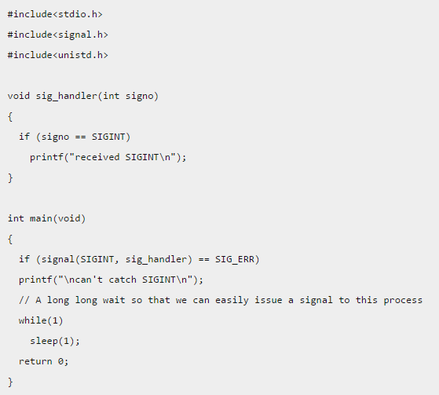
Example

Slide 73
Notes and caveats on signal
Use sigprocmask() (and a host of related functions) to check or manipulate the signal mask
Read the man pages for caveats
If you use the above, watch for race conditions
Normally, other signals are not raised in a handler as by default blocked

Slide 74
Kernel handling of user-level signals
Kernel is involved in user-level signal handling because
Need to interrupt the user process and later resume it
Signal may arise from exceptions triggered from hardware
Signals may be sent from one process to another requiring OS checking and intervention
Each process has its own set of signal handlers
Each process can also have a list of pending signals
In multicore systems, possible race conditions
Need to guard data structures with locks

Slide 75
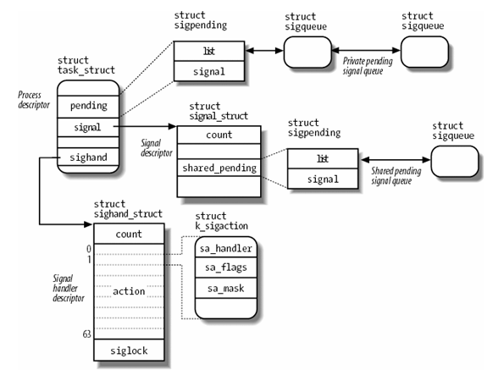
Main data structure for signal handling

Slide 76
The two phases
Signal generation
Kernel can send signal to user process
Another process may send signal to a user process
See functions in kernel/signal.c
Update the relevant process(es) data structures
Updates the pending signal list
If sending another process, and target is sleeping, “kick” that process so that signal will be delivered
If sending another process, and target is not sleeping, do an interprocessor interrupt
Signal delivery
Set up invocation of the user level signal handler

Slide 77
Signal delivery
Before an interrupt routine (in kernel mode) returns to user mode, pending signal is checked
If condition is right, arch_do_signal_or_restart is called which in turns call
arch_do_signal_or_restart is given the current process’ context and signal mask
If no handler, arch_do_signal_or_restart performs the default action; a core dump (usually)
If there is a handler, arch_do_signal_or_restart will call handle_signal()

Slide 78
handle_signal()
Copies process context from kernel stack into user space stack
Force EIP to point to first instruction of handler
Manipulate user stack such that the handler will return onto the stack which will make a system call to sigreturn()
Cannot just return simply coz handler may make other system calls – including ones using “int 80h” – an interrupt!
After all these setup, do a true return to user mode

Slide 79
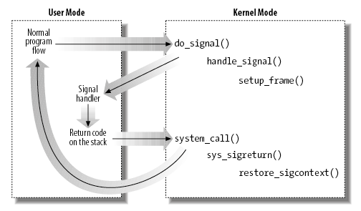
Linux signal delivery
arch_do_signal_or_restart()
Setup_rt_frame()

Slide 80
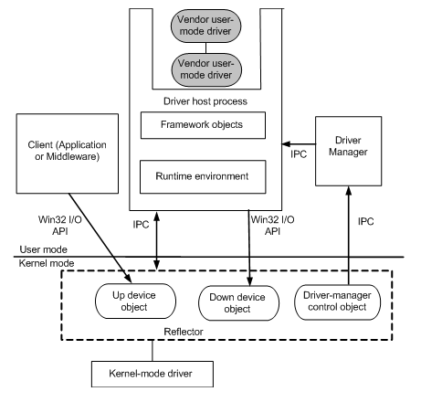
A Quick Word about Windows
User-Mode Driver Framework (UMDF)
UMDF drivers can handle hardware interrupt via the framework
Interrupt objects are created and registered with the framework
Same two-half philosophy:
OnInterruptIsr – do bare minimum
OnWorkItem – deferred processing for non-critical part of interrupt processing

Slide 81
The future is coming

Slide 82
Linus Torvalds’ Gripe about x86 interrupt handling
IDT itself is horrible, nasty
%rsp not being restored properly by return-to-user mode
delayed debug traps into supervisor mode
several bad exception nesting problems
various atomicity problems with swapgs and stack pointer switching
several different exception stack layouts, and literally hundreds of different entry points for exceptions, interrupts and system calls
https://www.realworldtech.com/forum/?threadid=200812&curpostid=200822

Slide 83
AMD’s Supervisor Entry Extensions
https://www.amd.com/system/files/TechDocs/57115.pdf
Not finalized
Better SYSCALL/SYSRET actions
Kernel must do certain standard things with potential of non-atomicity
Re-entrant Exceptions
The same exception occurring during the servicing of that exception

Slide 84
AMD: Enhanced SYSCALL/SYSRET (ESC)
A new MSR introduced that holds the kernel %rsp
For SYSCALL/SYSRET
At a Enhanced SYSCALL:
Enter Ring 0
Do a SWAPGS
Swap %rsp with the value in the new MSR
Create a standard exception frame is on the new stack that contains the next-RIP, CS, RFLAGS, RSP, and SS at the time that SYSCALL was executed
Load new %rip from the SYSCALL MSR

Slide 85
AMD: Reentrant Interrupts
A new MSR that contains a bit vector corresponding to x86 exception vectors 0-31. Out of reset, this MSR is set to 0. If bit N is set in this MSR, it means that exception N is in some stage of being handled by software
New Re-entrant Protect (RP) bit in IDT to specify if protection is to be enabled

Slide 86
AMD: Addition to Interrupt Processing
As before except if RP bit is set, then two additional actions:
Check the corresponding bit in the new MSR:
If that bit is 1, generate a double fault. If already in double fault, BSOD!
If that bit is 0, set that bit and push on as normal
A 1 byte exception record is written to a new field in the exception frame
After finishing the current exception processing, then software can decide what to do about this second exception of the same nature

Slide 87
Intel’s proposal: FRED
Flexible Return and Event Delivery (FRED)
https://linuxreviews.org/images/c/ca/Intel-346446-flexible-return-and-event-delivery.pdf
Bypass IDT using a new context and a new MSR (IA32_FRED_CONFIG)
Two new return instructions:
ERETU: returns from Ring 0 to Ring 3
ERETS: returns from Ring 0 to Ring 0 (no transition)
Automatic SWAPGS operation
Introduces stack levels
Current Stack Level (CSL): a value from 0-3
Four new FRED RSP MSRs used to load %rip depending on CSL changes

Slide 88
FRED Event Delivery
Save up context in temporaries
Determine new %rip
If oldCPL = 3, %rip = IA32_FRED_CONFIG & ~FFFH
If oldCPL = 0, %rip = IA32_FRED_CONFIG & ~FFFH + 64
Determine new %rsp from oldCPL
If already at Ring 0, use same stack (with an option to decrement %rsp)
Push context into new stack
Push additional info about the event onto the new stack (event dependent)
Change CS, SS, and GS if oldCPL = 3
CPL ← 0

Slide 89
Addition things to note about FRED
SYSCALL/SYSENTER use FRED event delivery as all other interrupts and exceptions
No SYSRET/SYSEXIT
Use ERETS or ERETU
No word about reentrant exceptions
Must occur at Ring 0
Probably left to software to sort out

Slide 90
Status as of beginning 2022
Whitepaper proposals subject to change
No actual implementation yet
Stay tuned

Slide 91
End

